Slide 1
Machine Learning Techniques for Anomaly Detection in Solar Power Plants
Team 2

Slide 2
Problem Statement
Solar plants are important for meeting upcoming energy needs, but problems in these plants can cause significant losses.
Detecting anomalies is vital for solar power plant efficiency and performance.
Anomaly detection can be slow and involve human input.
Developing an efficient machine learning based system for anomaly detection is necessary.

Slide 3
Objective, Community Impact, Creativity
The goal is to detect the anomalies in the photovoltaic (PV) system.
Community Impacts
Increased reliability and efficiency of solar energy
Reduced energy costs
Improved air quality
Creativity
Hybrid deep learning models for improved performance

Slide 4
Dataset
Data is gathered from two solar plants located in India, one in Gandikotta, Andhra, and another in Nasik, Maharashtra.
The data were collected at intervals of 15 minutes for 34 days.
There are 22 inverter sensors on each plant that measure AC and DC power generation.
A total of four CSV files are created from the data, partitioned by the plant.
The power generation and weather sensor data CSV files are available for each plant.
Table A and Table B show the metadata of each file in the next slides.

Slide 5
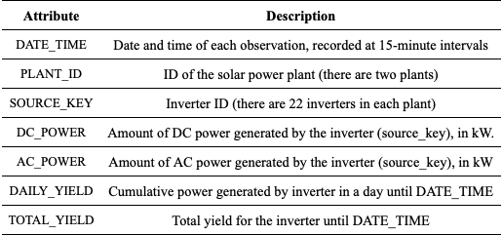
Dataset (cont’d)
Table A: Description of plant generation CSV file.

Slide 6
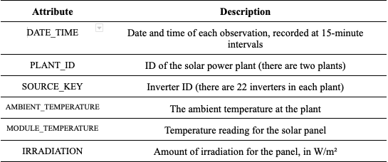
Dataset (cont’d)
Table B: Description of plant weather sensor CSV file.

Slide 7
EDA: Data Quality Assurance
Ensure each data file corresponds to only one Plant
Check for missing values
Check num inverters per plant and num measurements per inverter
22 total inverters, measurements ranging between 3104 and 3155
Issue: Maximum difference of 51 entries corresponds to a difference of almost 13 hours!
Ready to merge power and weather sensor dataframes

Slide 8
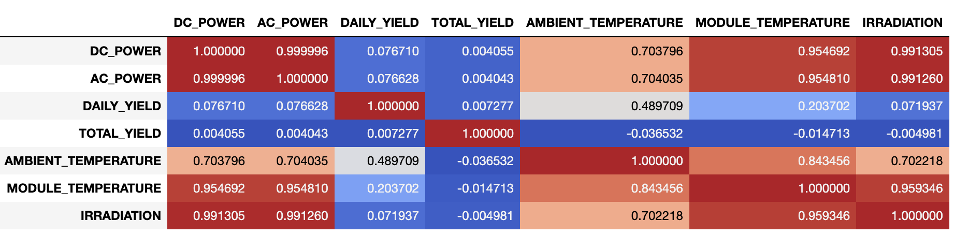
EDA: Correlations

Slide 9
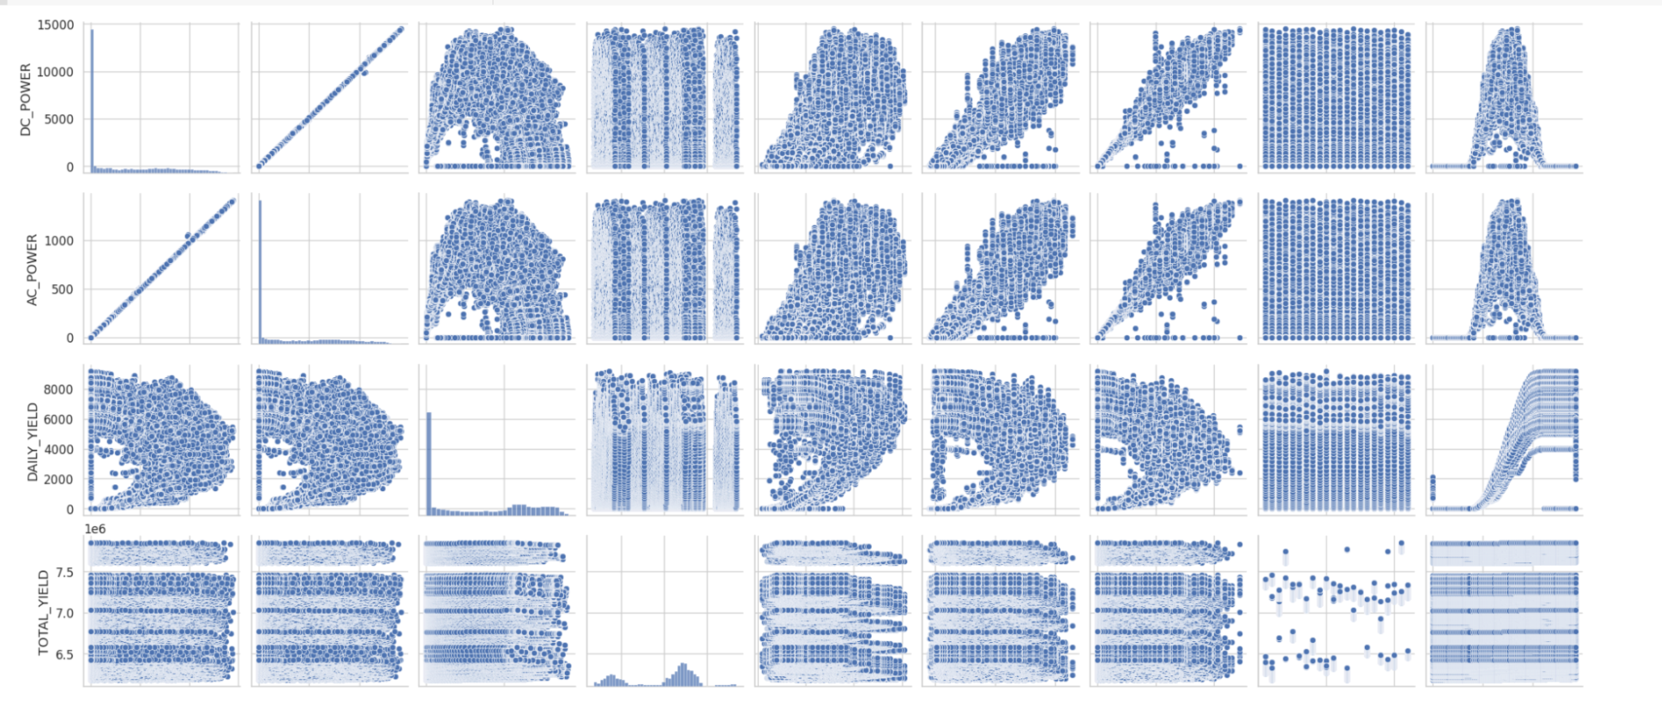
Pair Plot Correlations

Slide 10
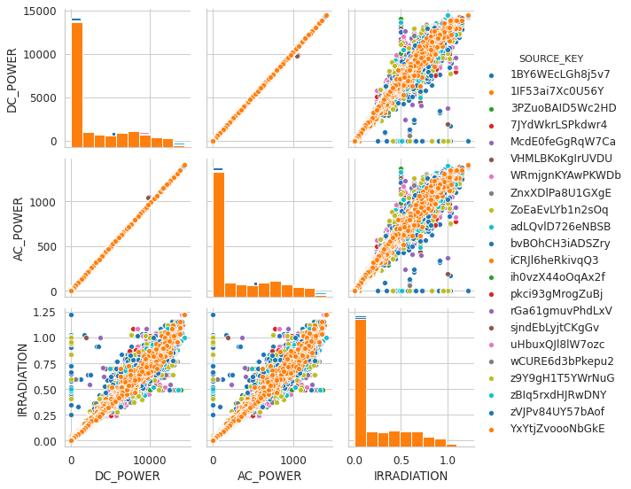
EDA: Pairplots
Outliers in
AC/DC - Irradiation [faulty solar panels]
AC - DC [faulty inverter]

Slide 11
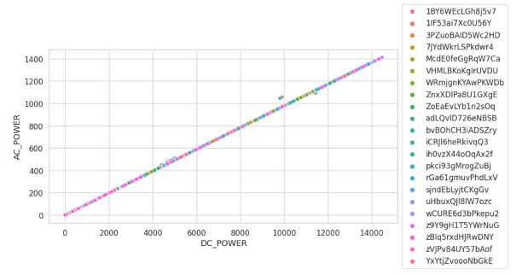
To understand conversion AC/DC

Slide 12
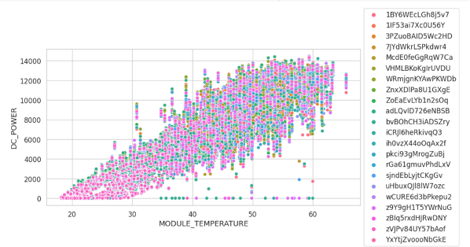
DC_POWER vs MODULE_TEMPRATURE

Slide 13
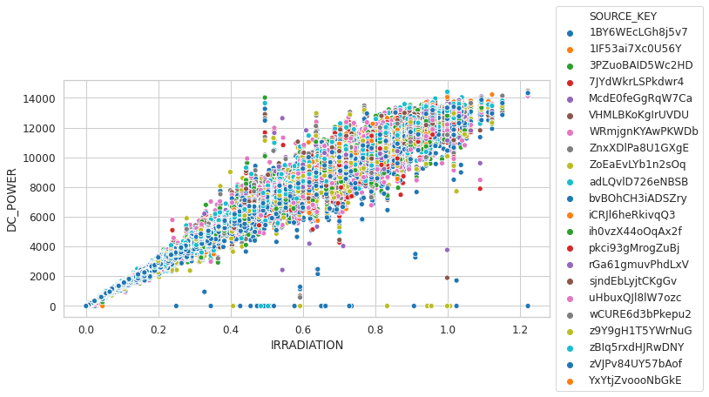
EDA: Power vs Irradiation

Slide 14
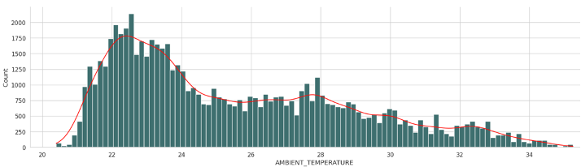
Temperature

Slide 15
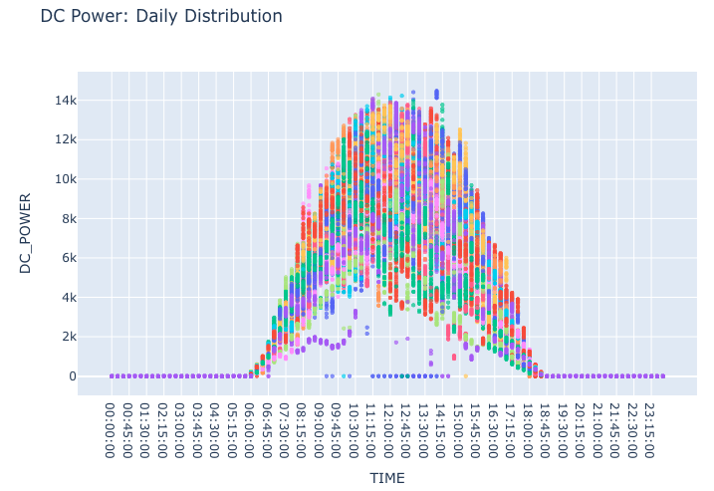
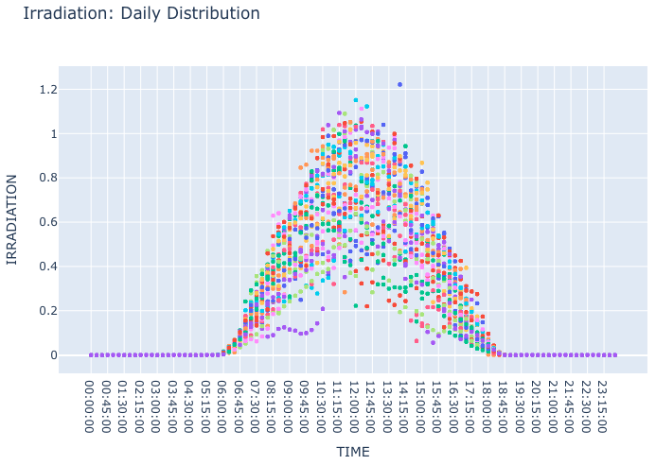
EDA: Power and Irradiation (cont’d)

Slide 16
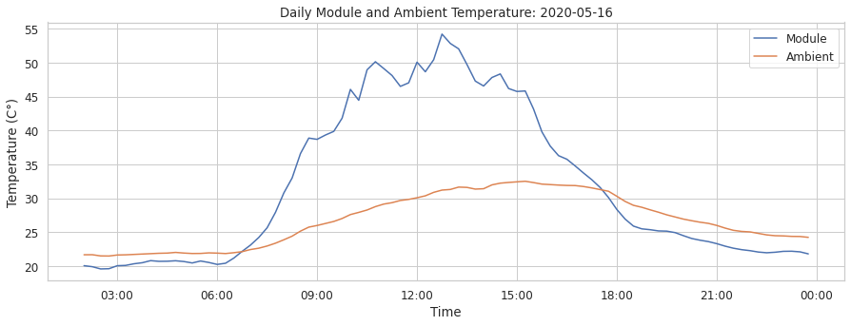
EDA: Temperature

Slide 17
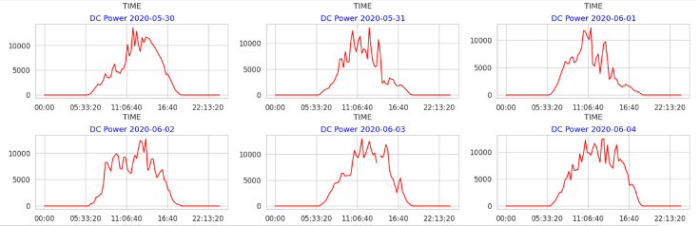
DC Power Distribution

Slide 18
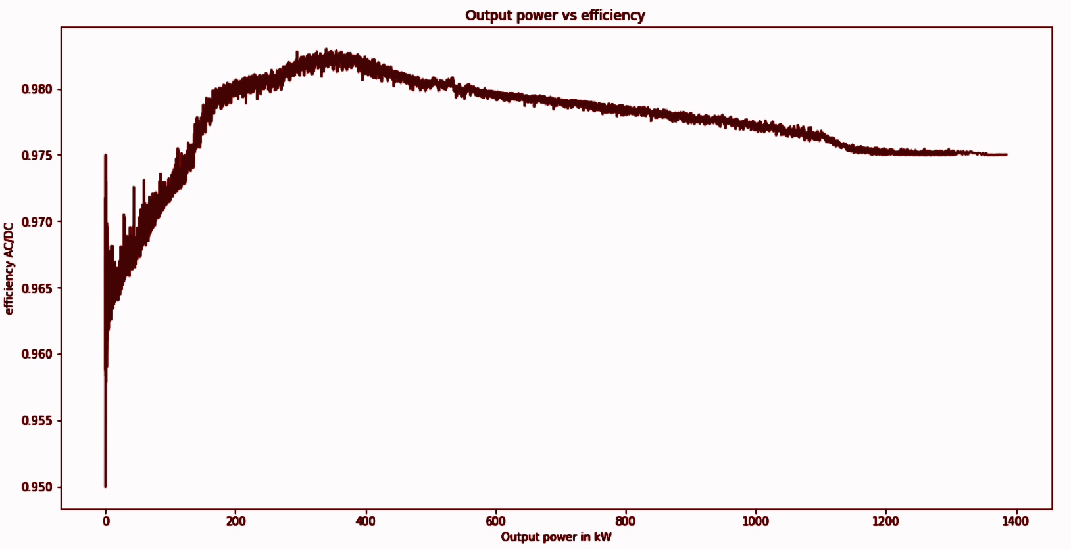
Efficiency Calculation

Slide 19
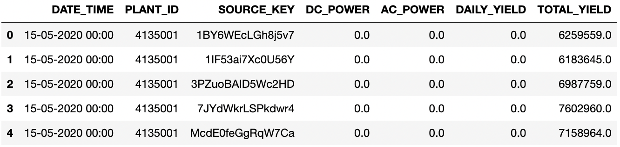
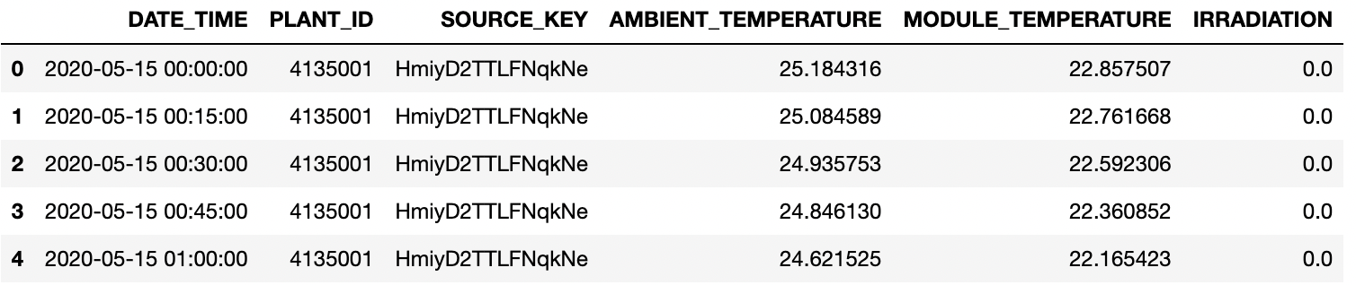
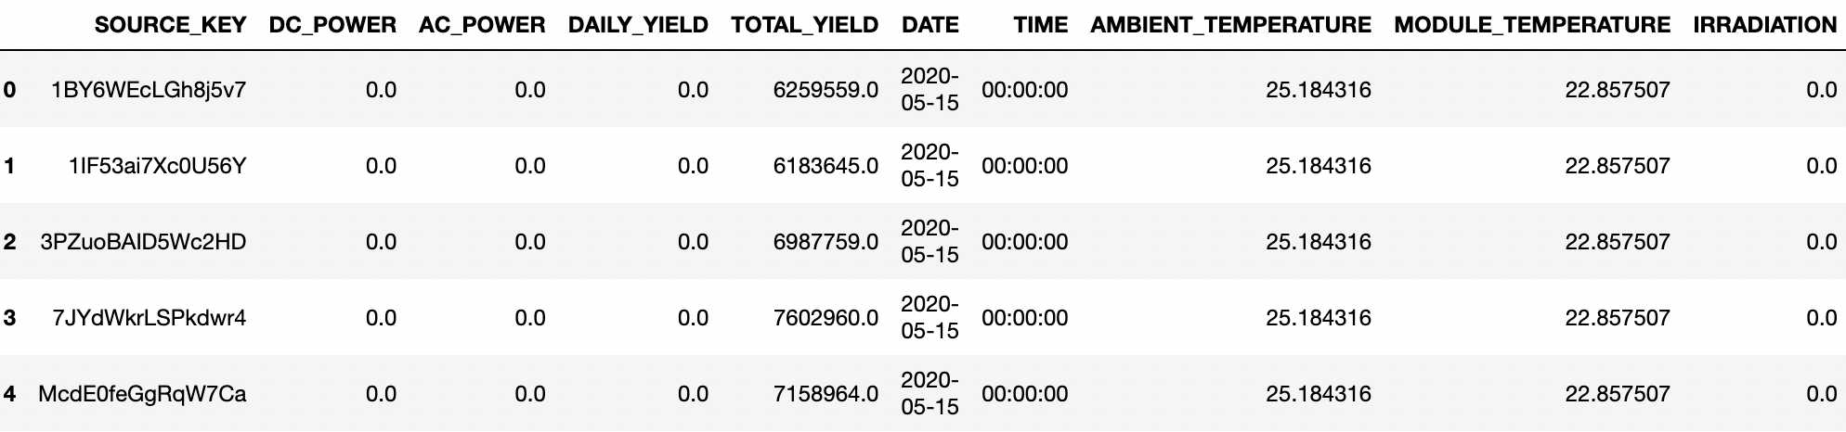
Data Preparation
Data Cleaning
Find missing values or duplicates
Replacing null or NaN values with median.
Data Integration
Combine generation data and weather data with same SOURCE_KEY based on DATE and TIME

Slide 20
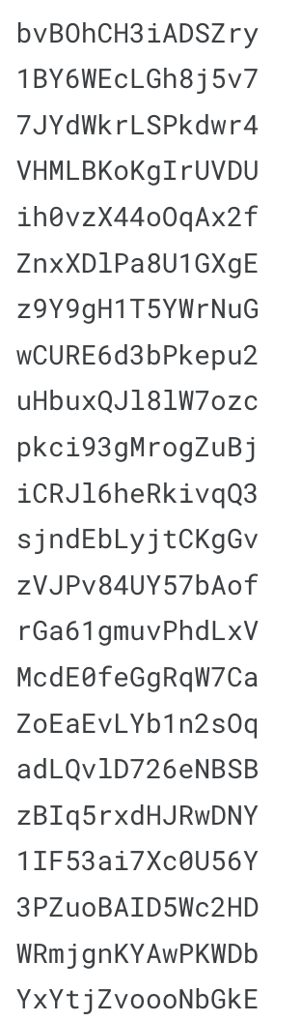
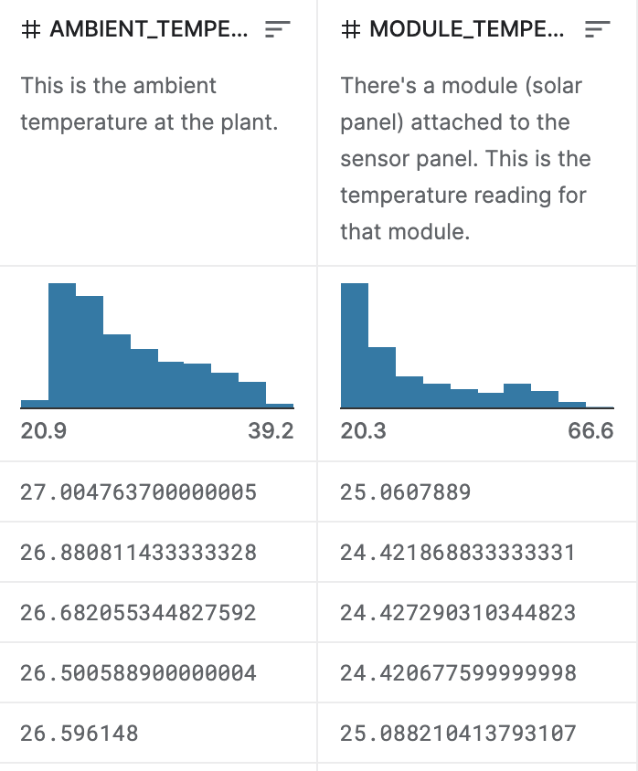
Data Preparation
Data Standardization
Defining date-time columns to maintain the same format = '%d-%m-%Y %H:%M'
There are only 22 inverters’ readings in the dataset.
Converting long type or character into a int data type for easier computation.

Slide 21
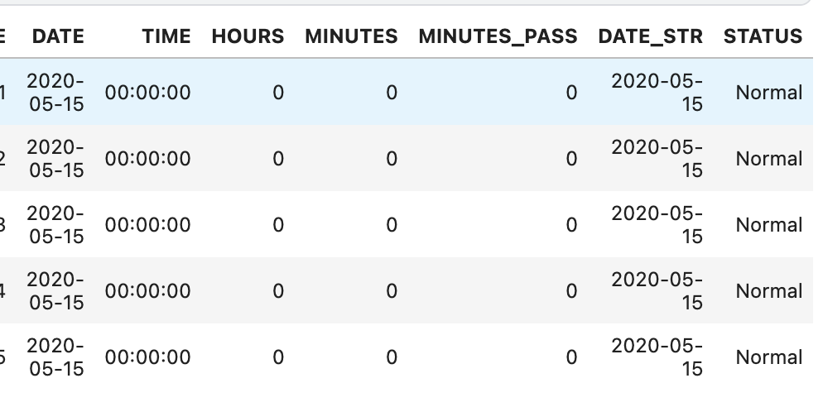
Data Preparation
Feature Engineering
We added separate date and time columns.
Added Plant Status to monitor the plant’s operational status using rule-based method.

Slide 22
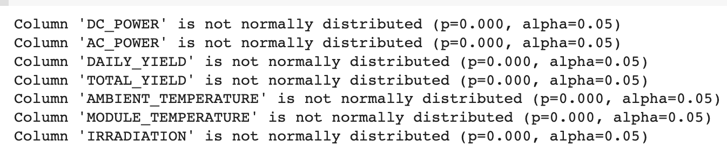
Check if Data is Normally Distributed
The Shapiro-Wilk test and QQ Plot is a statistical test used to determine if a sample of data comes from a normal distribution.

Slide 23
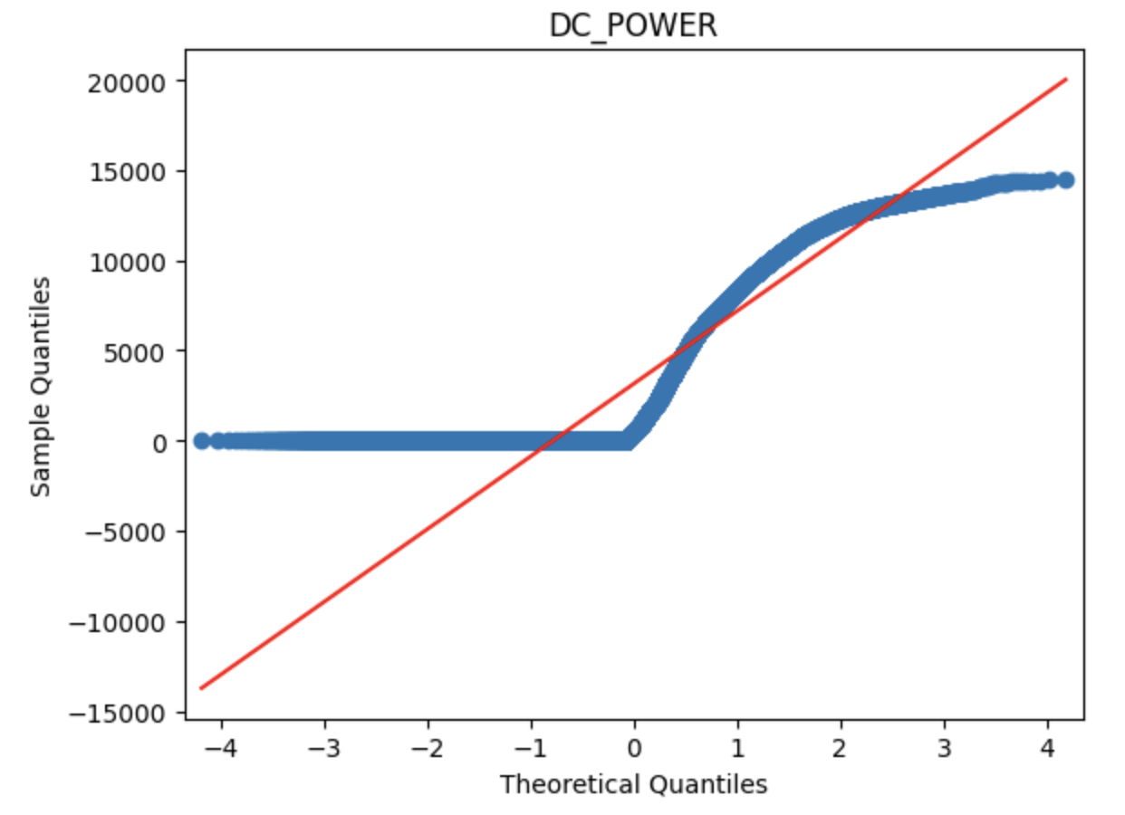
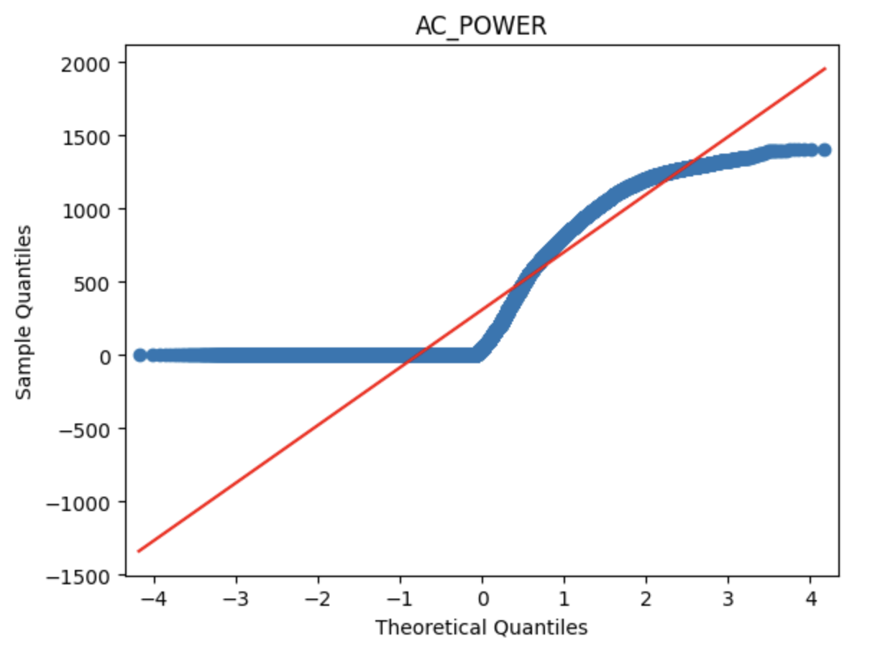
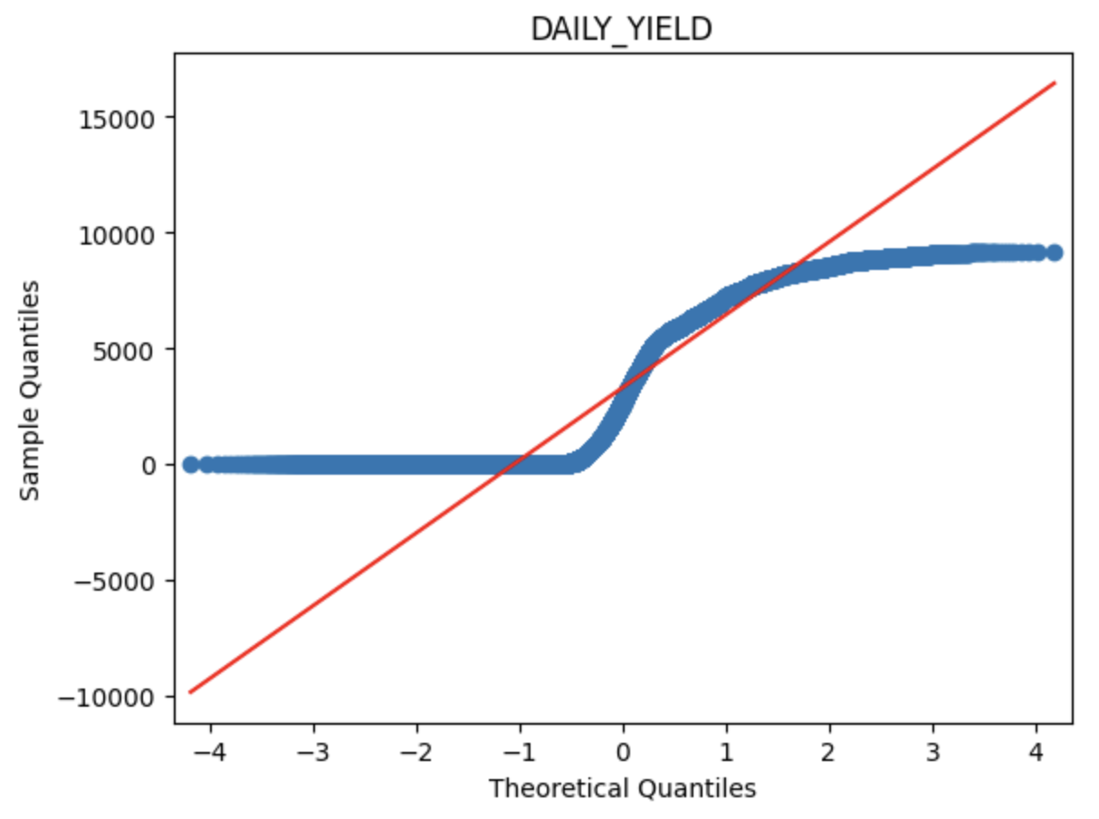
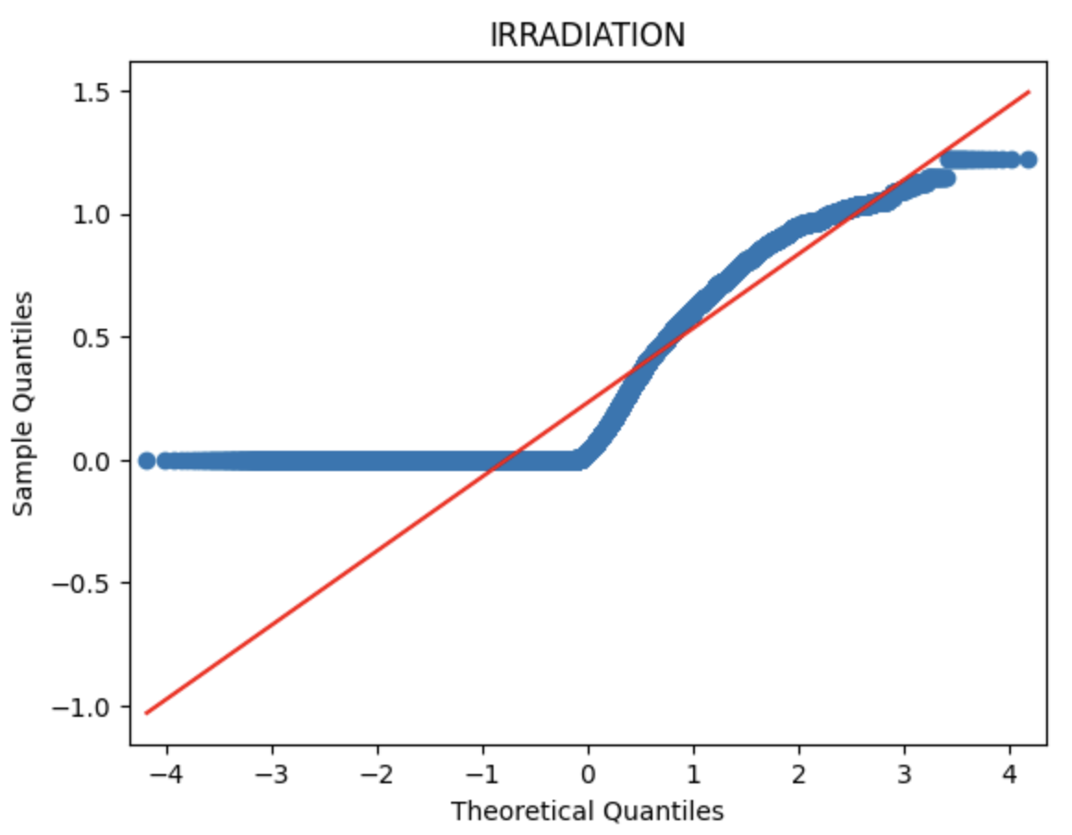
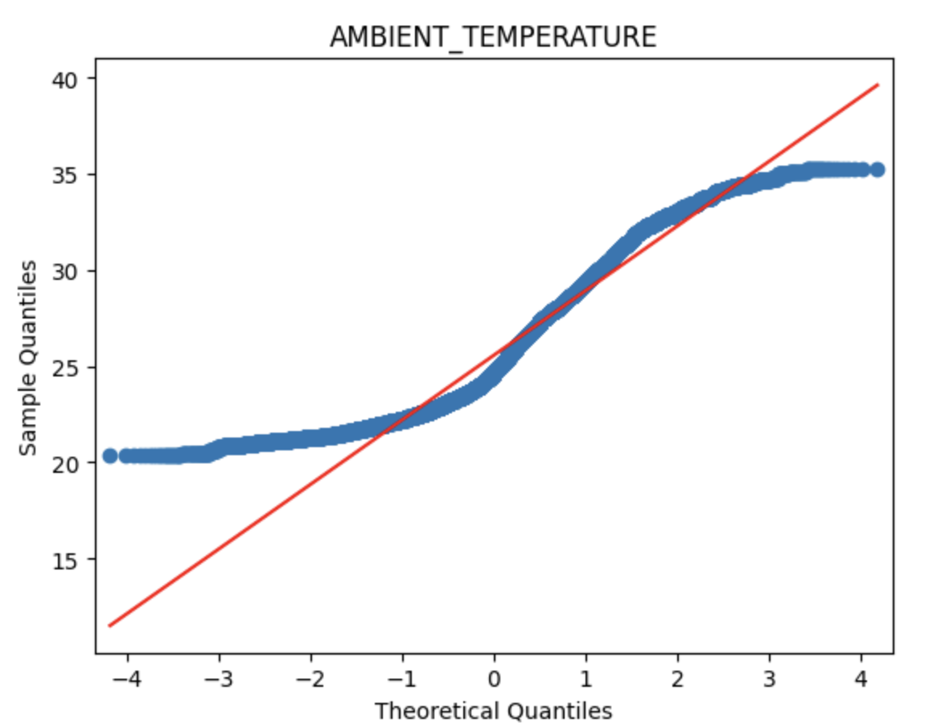
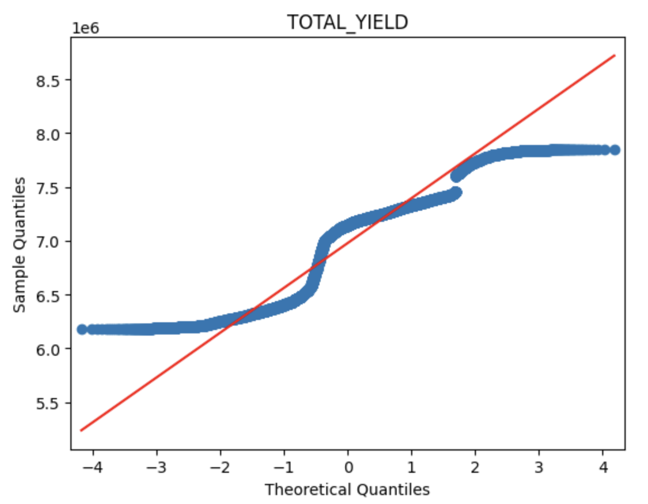
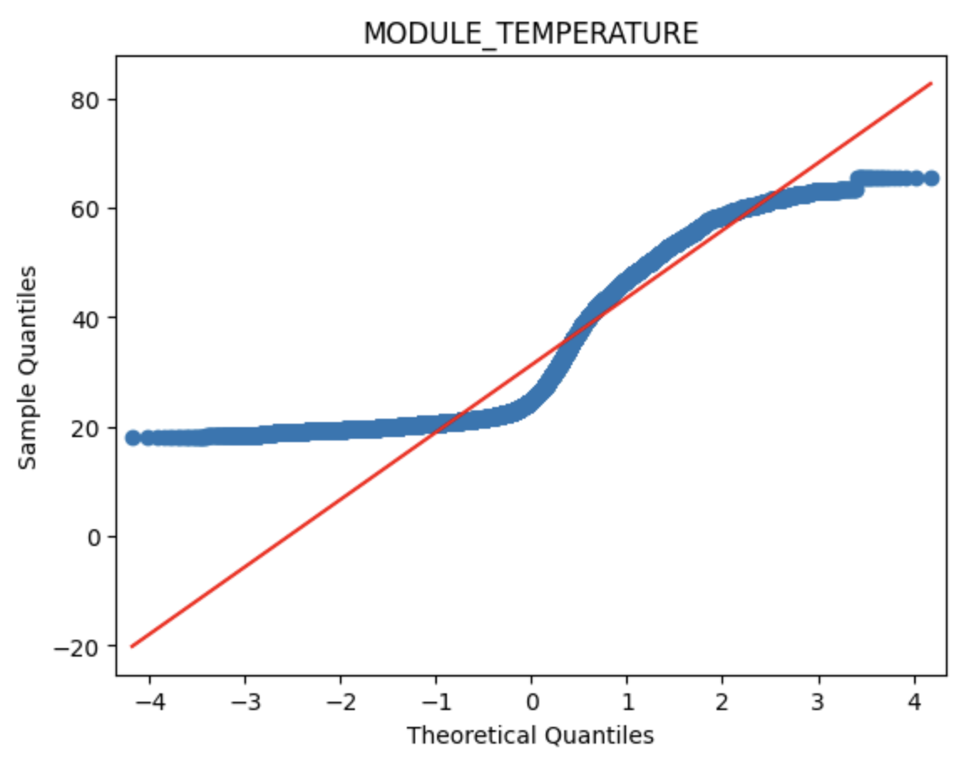
Using QQ Plot

Slide 24
Data Scaling
Min-max scaler (range 0-1)

Slide 25
Data Split
60:40 train-test split
90:10 train-validation split

Slide 26
Models
Regular LSTM
MLP with LSTM encoder
CNN-LSTM
Transformer

Slide 27
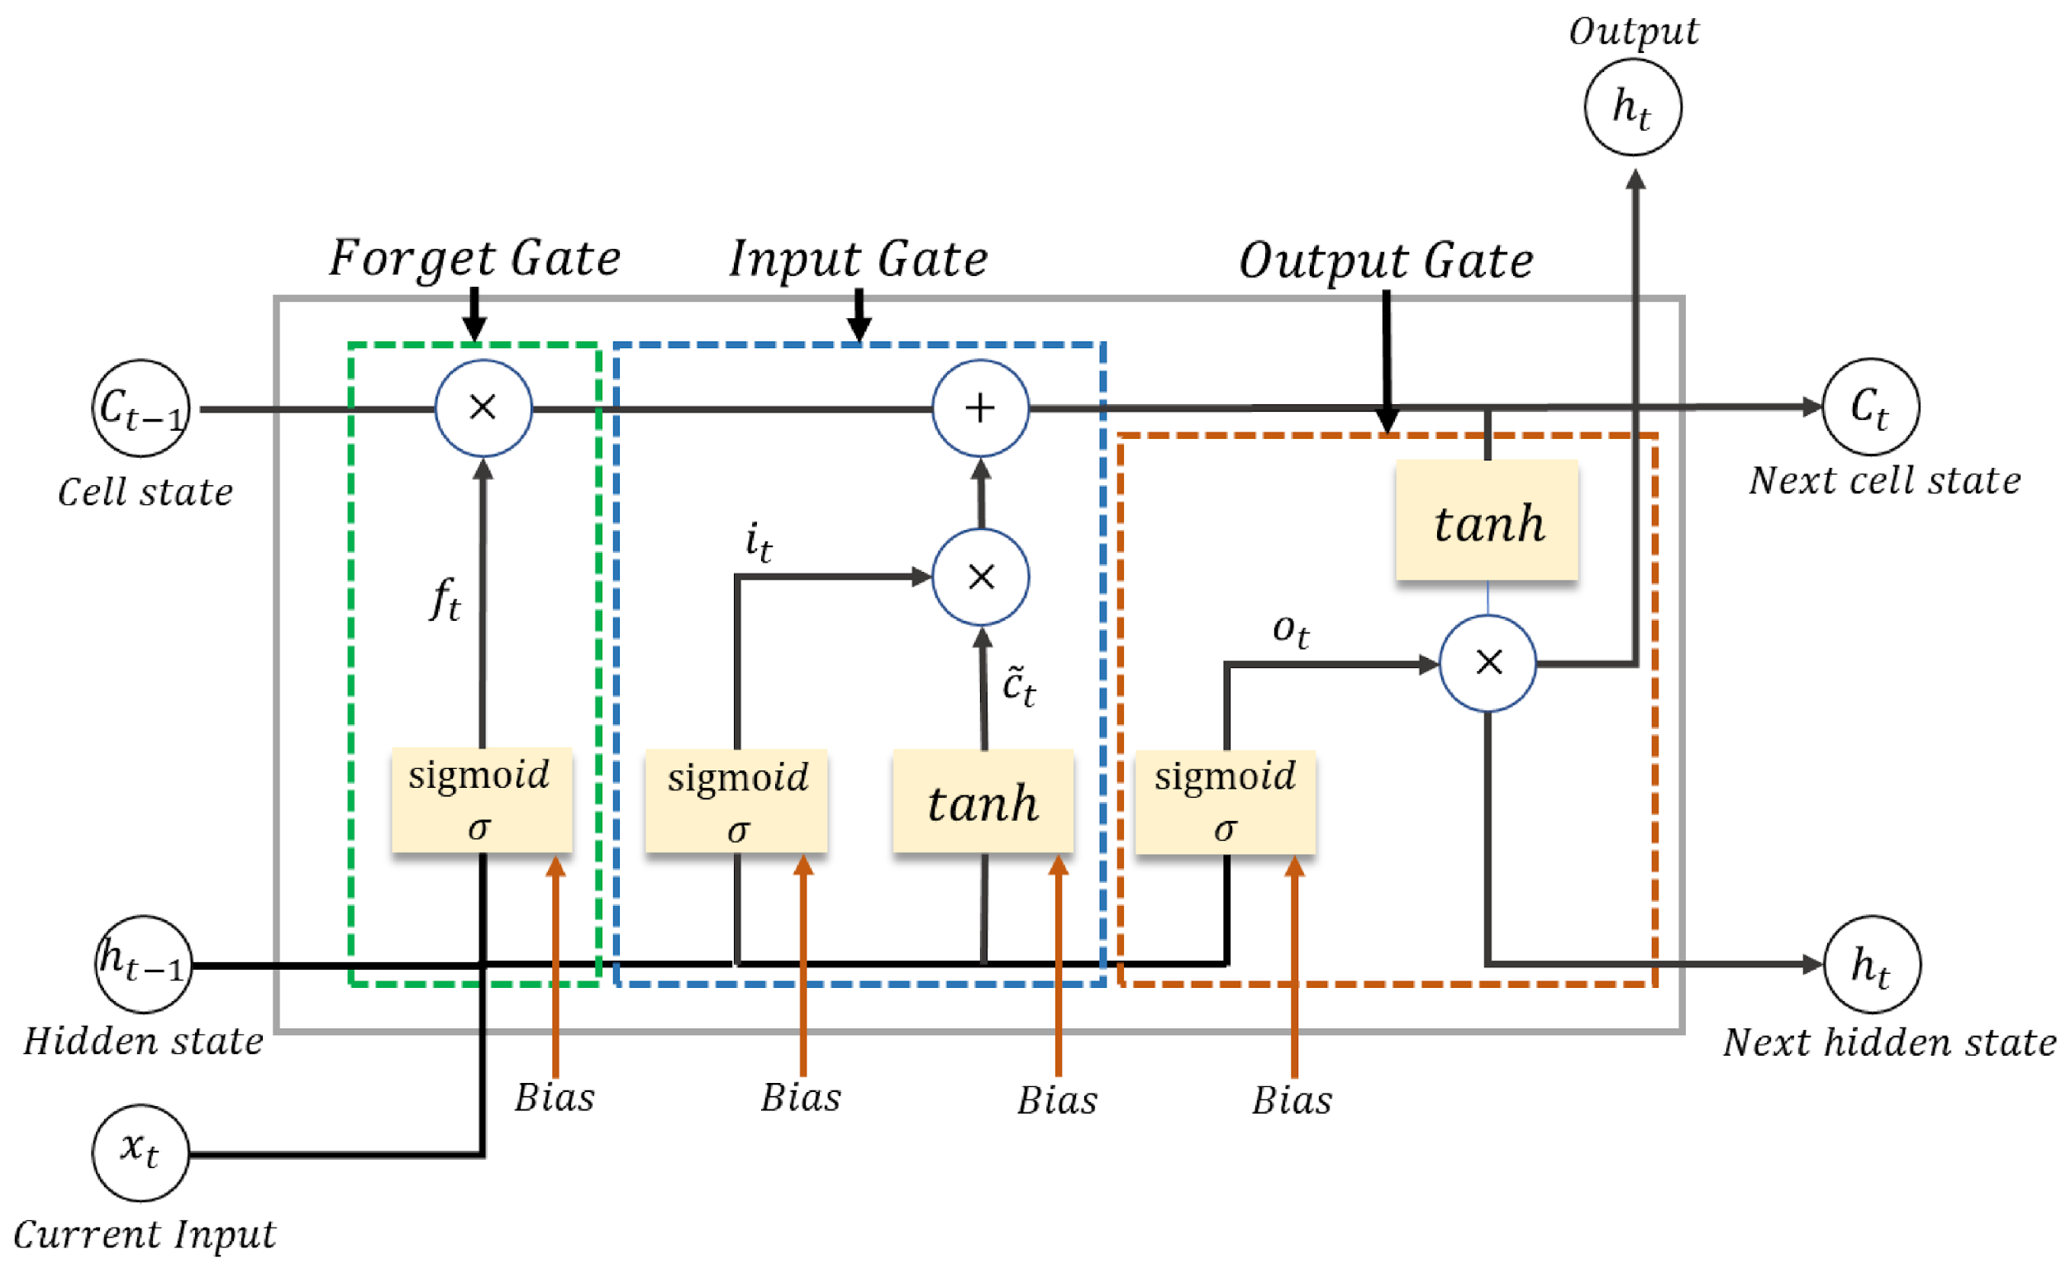
LSTM
https://colah.github.io/posts/2015-08-Understanding-LSTMs/

Slide 28
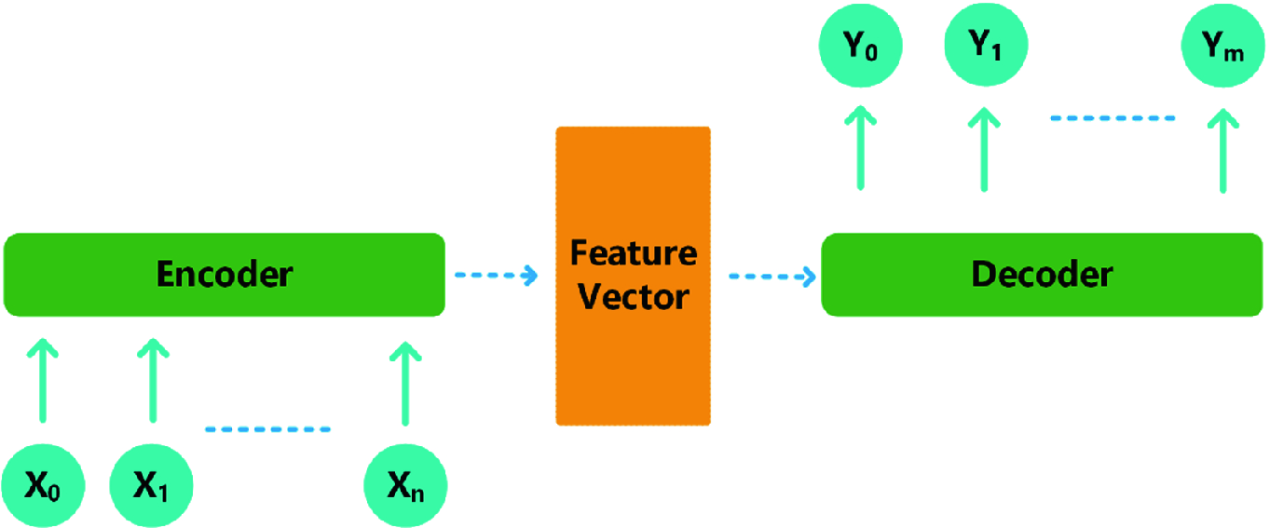
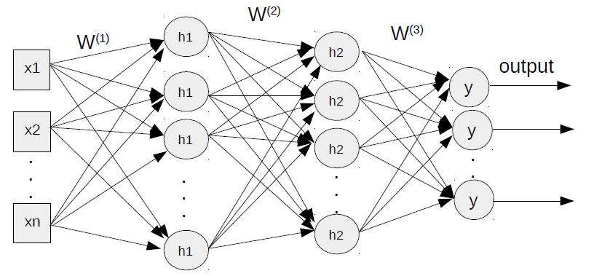
MLP with LSTM Encoder
1
2
https://nasirml.wordpress.com/2017/12/16/multi-layer-perceptron-in-tensorflow-part-2-mnist/
https://analyticsindiamag.com/using-encoder-decoder-lstm-in-univariate-horizon-style-for-time-series-modelling/

Slide 29
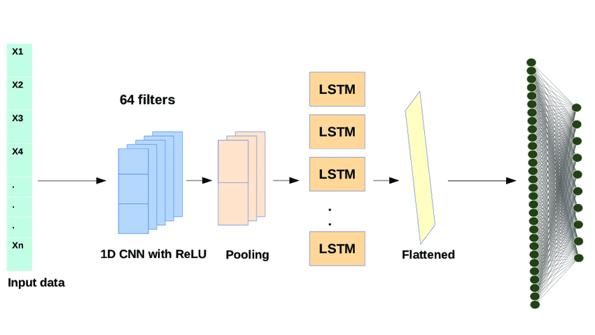
CNN-LSTM
14 filters
https://www.researchgate.net/figure/Architecture-of-the-Hybrid-1D-CNN-LSTM-model-for-human-activity-recognition_fig4_343341551

Slide 30
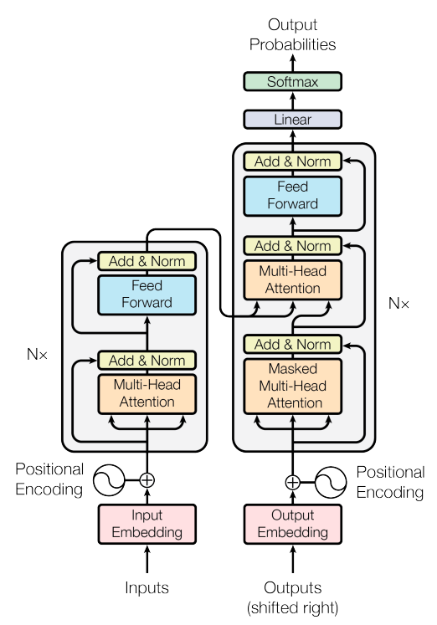
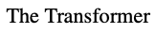
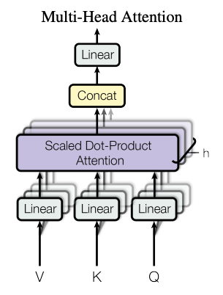
Transformer

Slide 31
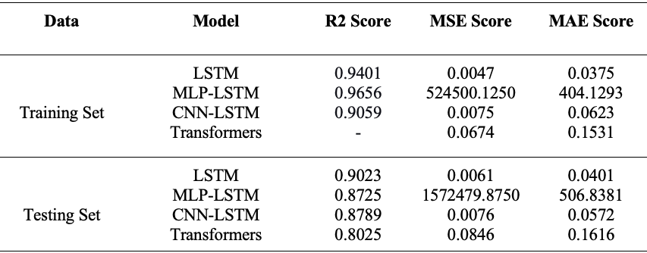
Results: DC Power Prediction

Slide 32
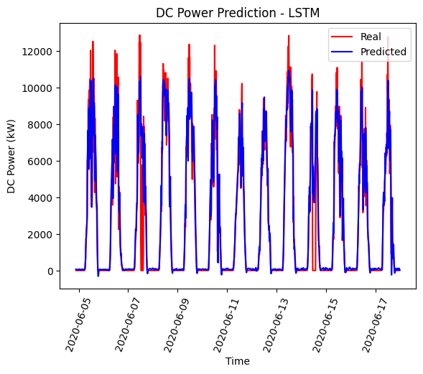
Results: DC Power Prediction - LSTM

Slide 33
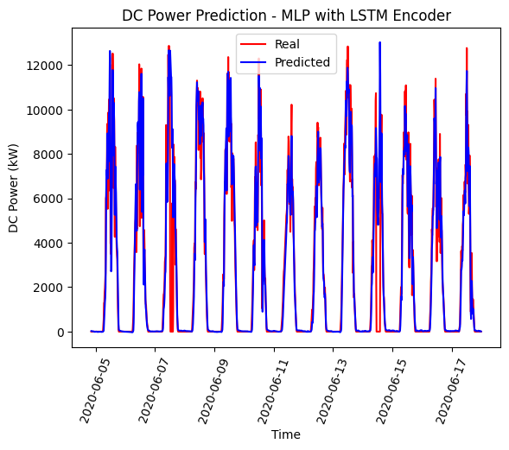
Results: DC Power Prediction - MLP with LSTM Encoder

Slide 34
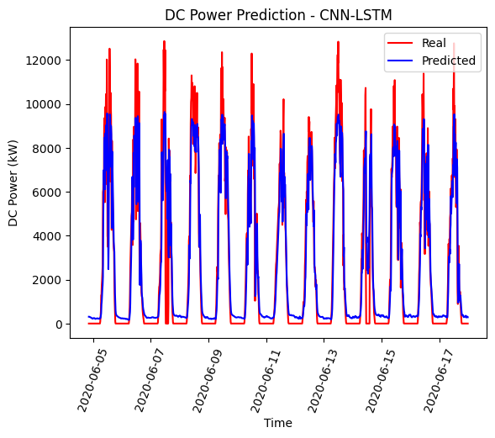
Results: DC Power Prediction - CNN-LSTM

Slide 35
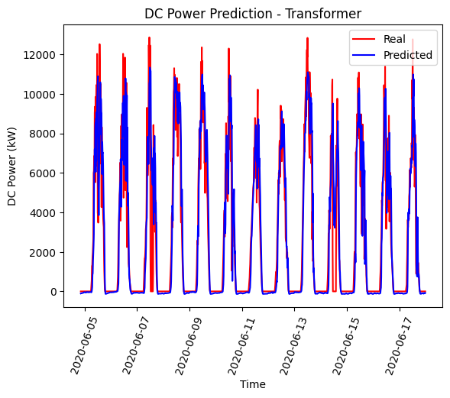
Results: DC Power Prediction - Transformer

Slide 36
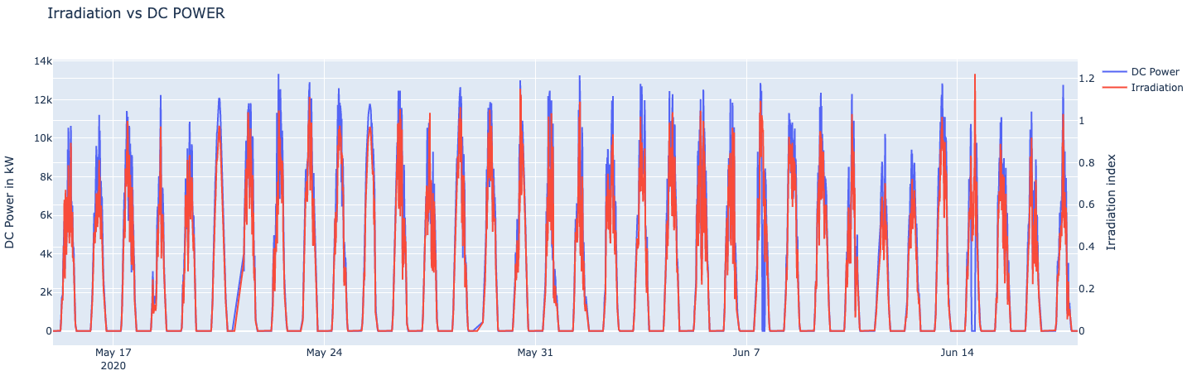
Anomaly Detection: DC Power vs Irradiation

Slide 37
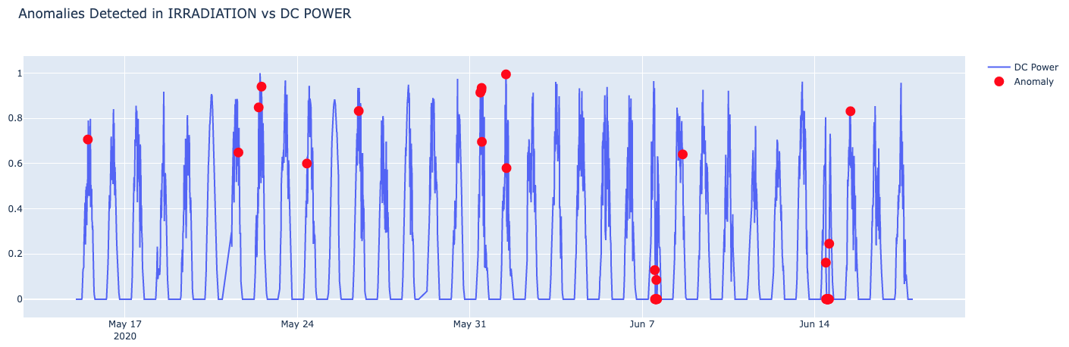
Anomaly Detection: True Anomalies

Slide 38
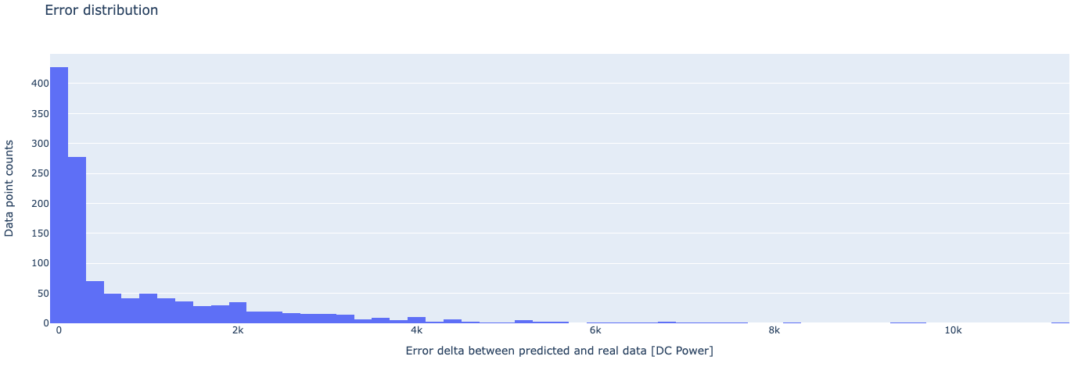
Results: Absolute Error - LSTM
Distribution of absolute error between real and predicted DC Power for LSTM

Slide 39
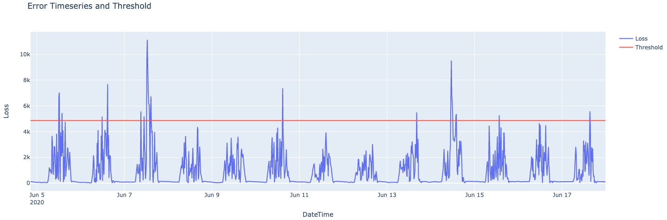
Results: Absolute Error - LSTM (cont’d)
Absolute errors above threshold are anomalies.
Threshold = mean(absolute error) + 3 std(absolute errors)

Slide 40
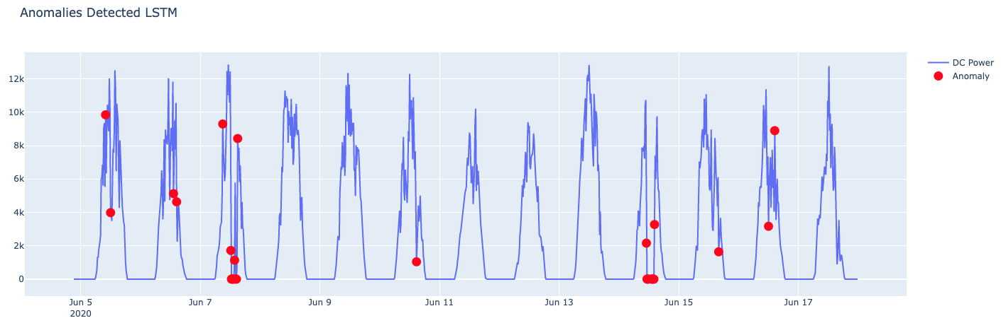
Results: Anomaly Detection - LSTM

Slide 41
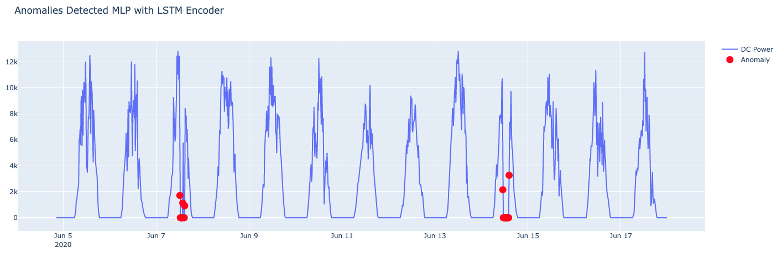
Results: Anomaly Detection - MLP with LSTM Encoder

Slide 42
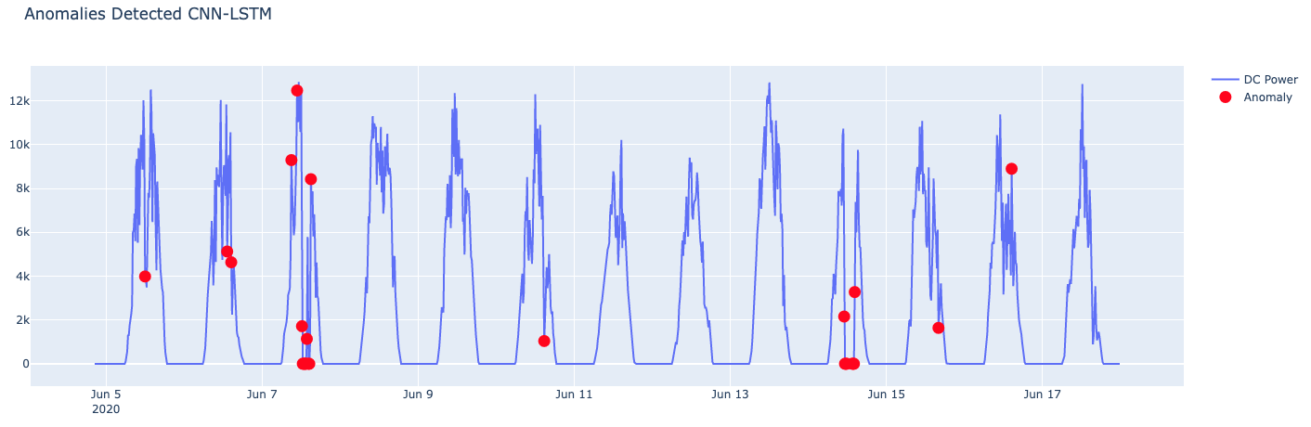
Results: Anomaly Detection - CNN-LSTM

Slide 43
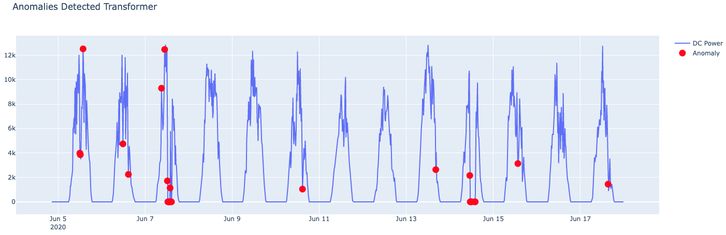
Results: Anomaly Detection - Transformer

Slide 44
Results: Anomaly Detection
Model | Accuracy
Transformer | 0.9838
LSTM | 0.983
MLP with LSTM | 0.9984
CNN-LSTM | 0.9830

Slide 45
Conclusions
Best model
MLP with LSTM encoder
Future scope
Refined anomaly detection techniques
Gaussian method for anomaly detection
Refined parameter optimization techniques
Grid search

